Slide 1
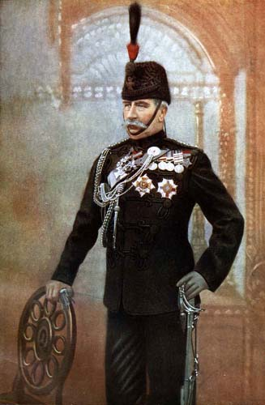
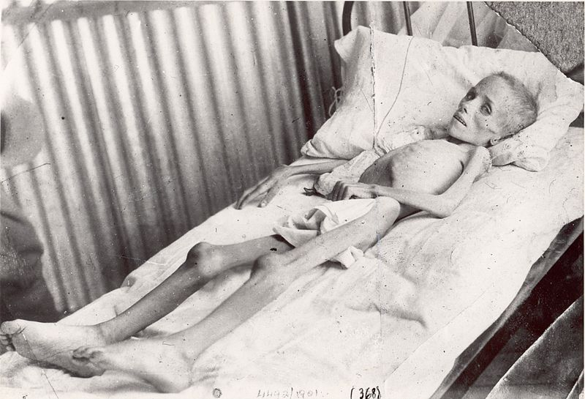
The 2nd Boer War
The British Vs. The Boer’s

Slide 2
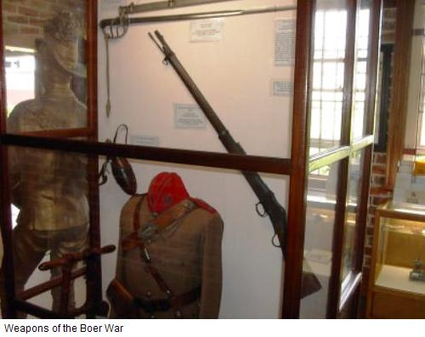
British Atrocities:
The British primarily used the Lee-Metford Mark I and II rifles
Could fire 20 rounds per minute
Factory defects initially made it inaccurate at 400+ yds.
The Boer’s used the Mauser Rifle

