Slide 1
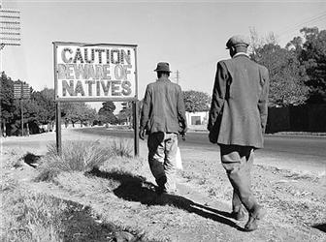
1913 Natives Land Act

Slide 2
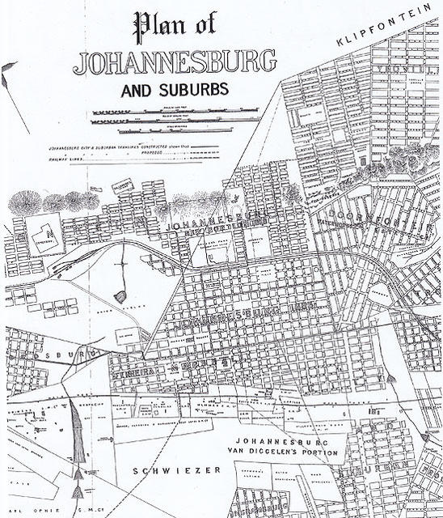
The Explosion of Johannesburg
Notes:
This is a map of Johannesburg from 1895 which shows how much it grew do to increased labor

Slide 3
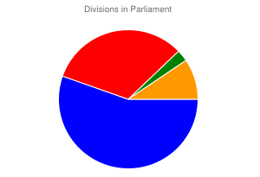
Notes:
This pie chart shows the divisions within parliament. Blue is the South African Party, red is the Unionist Party, green is Labour Party, and orange is independents. If 7 members of the SAP left, it would force a new government to be chosen.

Slide 4
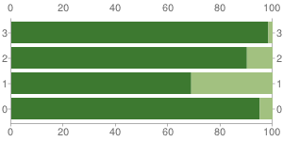
Graph of the Percentage of Land Owned in Each Province
Notes:
This graph shows the percentage of land owned by whites and blacks in each province, showing the infeasibility of having a uniform law. The top bar is the Orange Free State, the 2nd from top is the Cape colony, the 3rd from top is Natal, and the bottom is the Transvaal

Slide 5
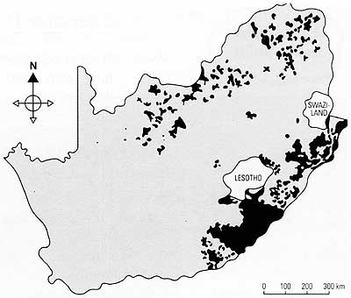
Notes:
The distribution of land in South Africa; black represents the reservations of the black African natives.

